Slide 1
Lightning Talk: Design Check-In
Hybrid Relightable 3D Gaussian Rendering: A Real-Time Novel View Synthesis System with Triangle Mesh Integration (sdmay25-40)

Slide 2
Project Overview
Our project is a novel view synthesis system that uses 3D Gaussian splats with a raytracer that allows for real time dynamic lighting and the incorporation of traditional polygon meshes.
Use a Machine Learning model to extract material properties from videos to allow for dynamic lighting.
Create a Unity package consisting of our renderer

Slide 3
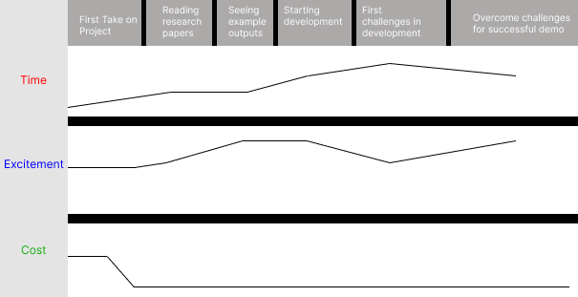
Journey Map

Slide 4
Design Pros and Cons
Pros:
Provides 3D Gaussian and standard file support (ex. .ply files)
Easy to use and doesn’t require knowledge of the system.
Easy Scene Showcasing Due to Unity Integration.
Free
Cons:
Model(s) will be run on users computer.
No mobile phone support.
Requires Unity (as it will be a unity package)

Slide 5
Human
User Needs being addressed:
Scene Generation & Realism
Scalability for Real-Time Rendering
Concern:
Data set adequacy:
More data may be needed to train and test models effectively as prototypes evolve to ensure they are as efficient as possible .

Slide 6
Economic
Real time Scene Rendering:
Improves upon alternative by integrating both 3D Gaussian models and Traditional Triangle meshes.
Real Time dynamic and relightable scenes.
Justification:
Research shows 3D Gaussians perform significantly faster than NeRFs

Slide 7
Technical
Internal Complexity:
The internal complexity in our design comes from the need to combine multiple advanced techniques.
This sophistication results in a higher quality output.

Slide 8
Technical
External Complexity:
The external complexity comes from the need to process both gaussians and traditional polygon meshes.
This complexity is justified because we feel that our user groups are best server by having the option to use both.

Slide 9
Conclusion
Our project design is adequately meeting user and functional needs.
The only area of concern is whether or not we have an adequate amount of training and test data point/sets

